Slide 1
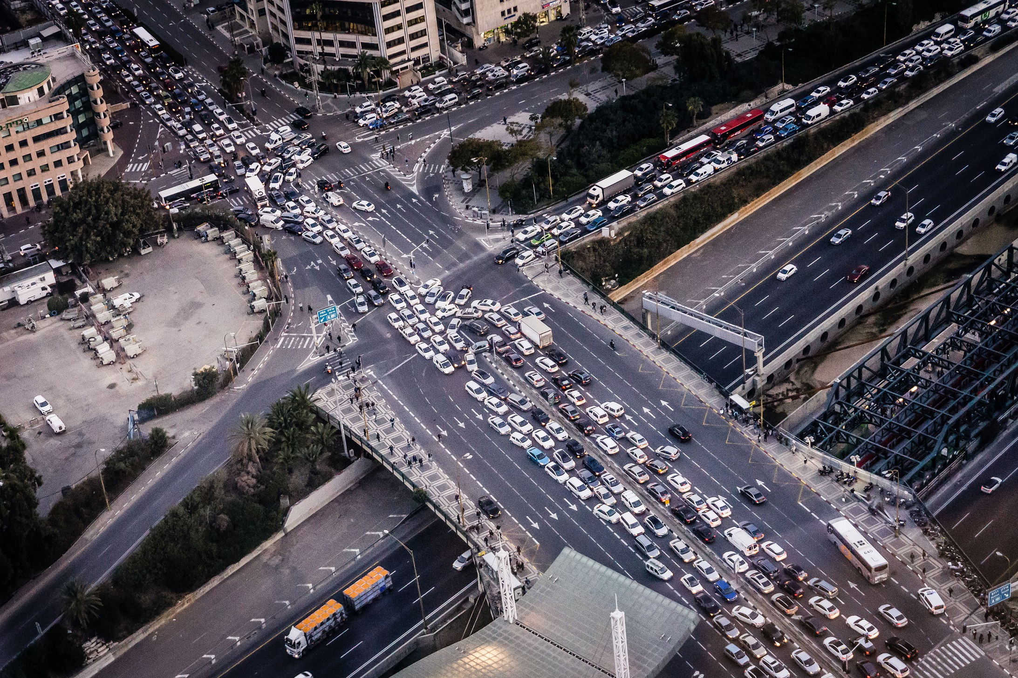
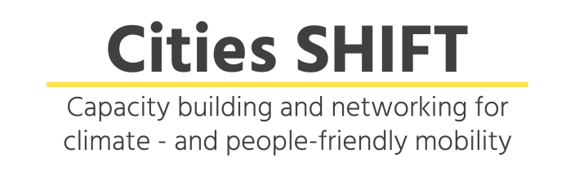



CitiesSHIFT Webinar #3
Improving urban air quality through ecomobility: Global overview and practical solutions
Thursday 29 August 2019 18:00 CEST

Slide 2
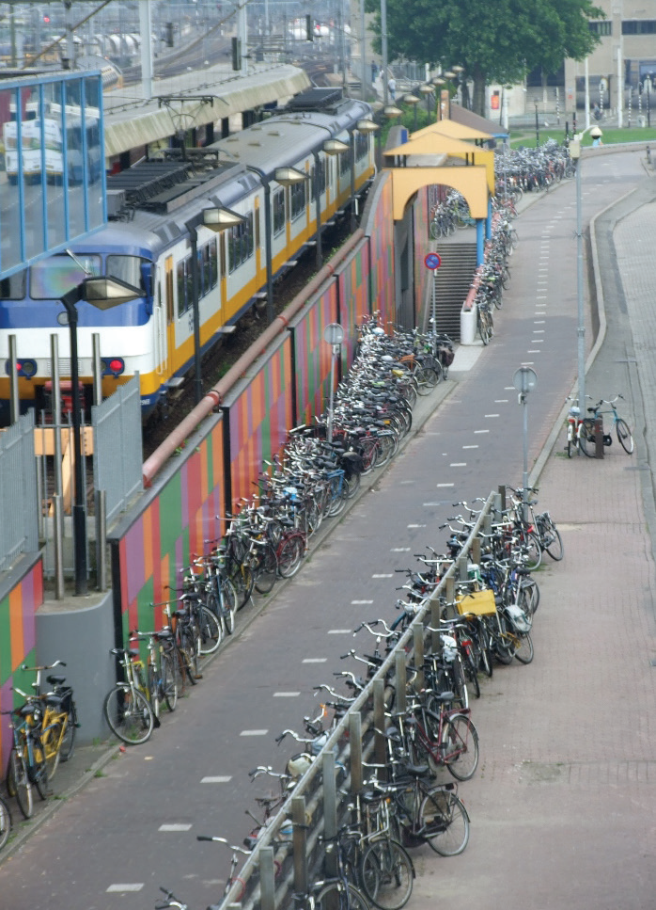

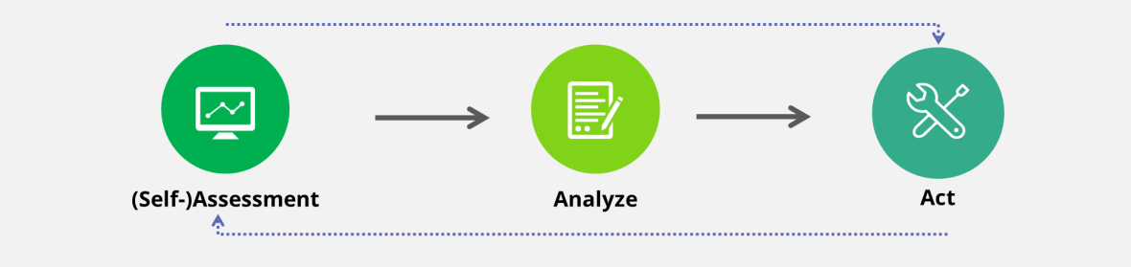


EcoMobility SHIFT+
A tool for cities to assess, analyze and act to implement solutions and improve mobility performance
2
Notes:
It looks at changing habits and travel behavior by offering attractive alternatives.

Slide 3
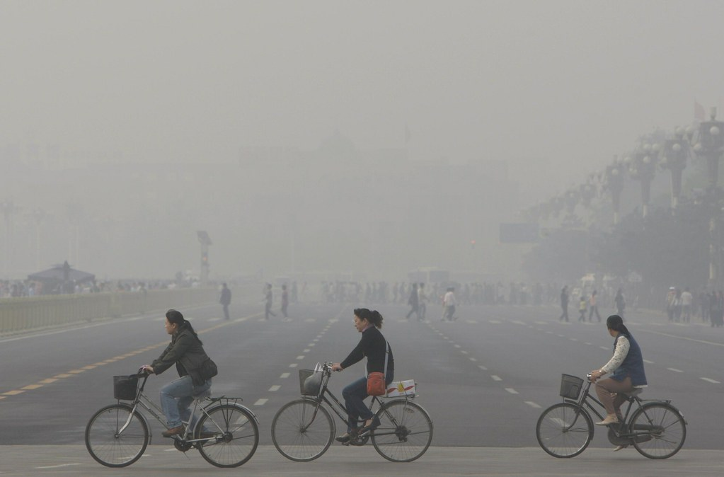
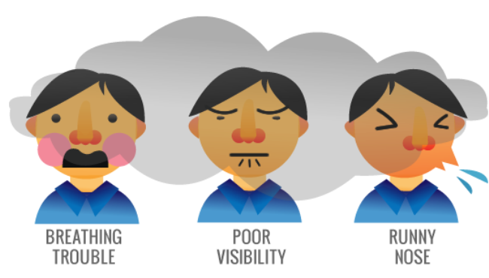
Air pollution
Nine out of ten people worldwide breathe polluted air (WHO, 2018).
Transportation tailpipe emissions were responsible for 11.7% of global mortality from PM2.5 and ozone exposure in 2010 and 11.4% in 2015 (ICCT, 2019).
Photo credit: Edison Jumawid/ Flickr
3

Slide 4
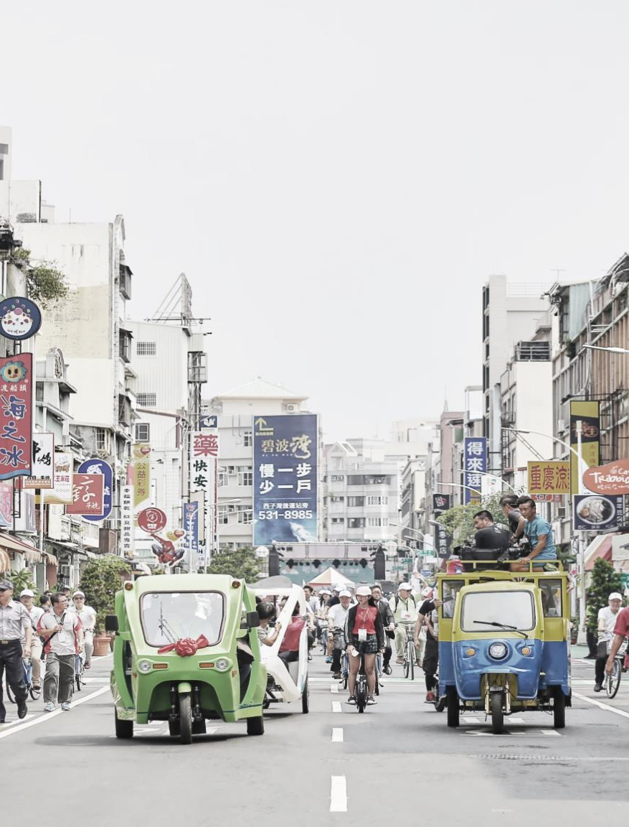

What is EcoMobility?
EcoMobility gives priority to walking, cycling, public transport, shared and light electric vehicles.
It promotes travel through integrated, socially inclusive, and environmentally-friendly transport options without depending on privately owned vehicles.
Cycling/
Wheeling
Public Transportation
Light electric vehicles
Walking
Sharing
Integrated and connected manner
Photo credit: Kaohsiung City Government
4
Notes:
EcoMobility is an environmentally sustainable form of mobility and accessibility that reduces people’s reliance on private motor vehicles.
It looks at changing habits and travel behavior by offering attractive alternatives.

Slide 5
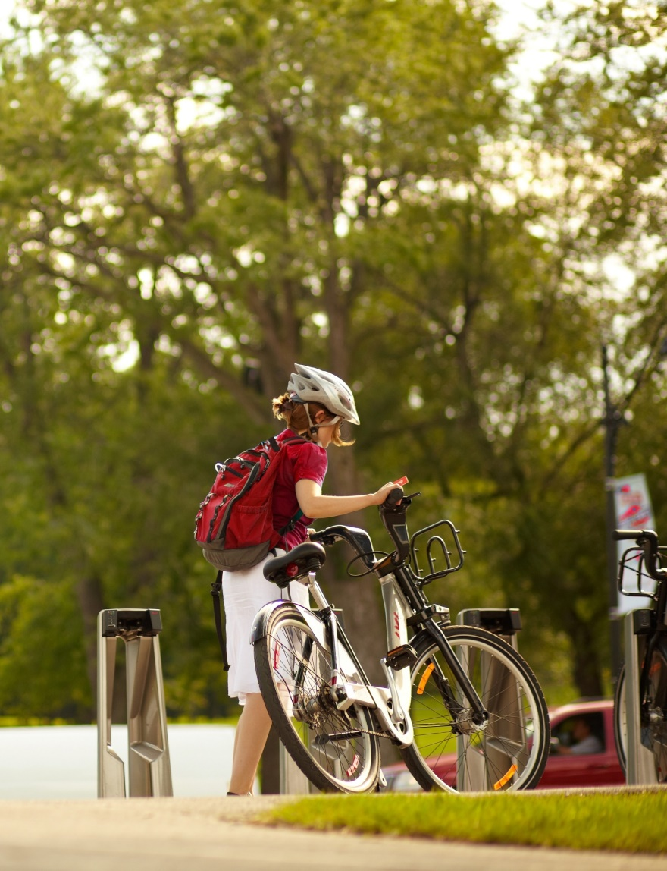
Agenda
Introduction by Yiqian Zhang - 5 minutes
Presentation by Prarthana Borah - 15 minutes
  Mobility solutions for clean air action planning
Presentation by Garrett Wong - 15 minutes
GoSaMo: Mobility & Sustainability in Santa Monica
Presentation by Camilla Ween - 15 minutes
  Shifting travel behaviour to improve air quality - some examples from UK & Europe
Q&A - 30 minutes
Final remarks - 5 minutes
Photo credit: Société de vélo en libre service
5

Slide 6
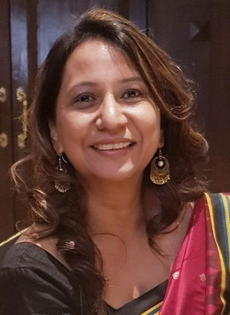
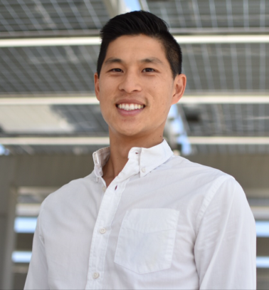
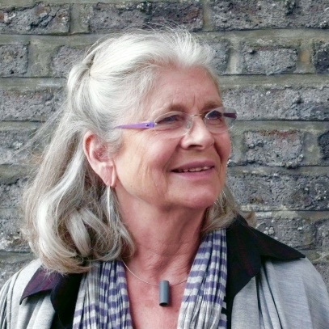
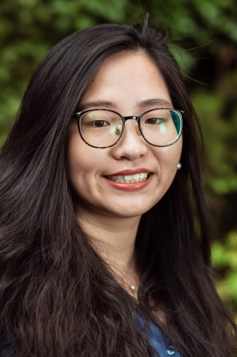
Speakers
Prarthana Borah
Director
Clean Air Asia India
Garrett Wong
Senior Sustainability Analyst
City of Santa Monica
CA, USA
Camilla Ween
Director of Goldstein Ween Architects, Chair of Trustees of Spacelink Learning Foundation, Past-President of Women in Transport
Yiqian Zhang (Moderator)
Sustainable Mobility Officer
ICLEI World Secretariat
Bonn, Germany
6

Slide 7
Q&A
Prarthana Borah
Director
Clean Air Asia India
Garrett Wong
Senior Sustainability Analyst
City of Santa Monica
CA, USA
Camilla Ween
Director of Goldstein Ween Architects, Chair of Trustees of Spacelink Learning Foundation, Past-President of Women in Transport
Yiqian Zhang (Moderator)
Sustainable Mobility Officer
ICLEI World Secretariat
Bonn, Germany
7

Slide 8
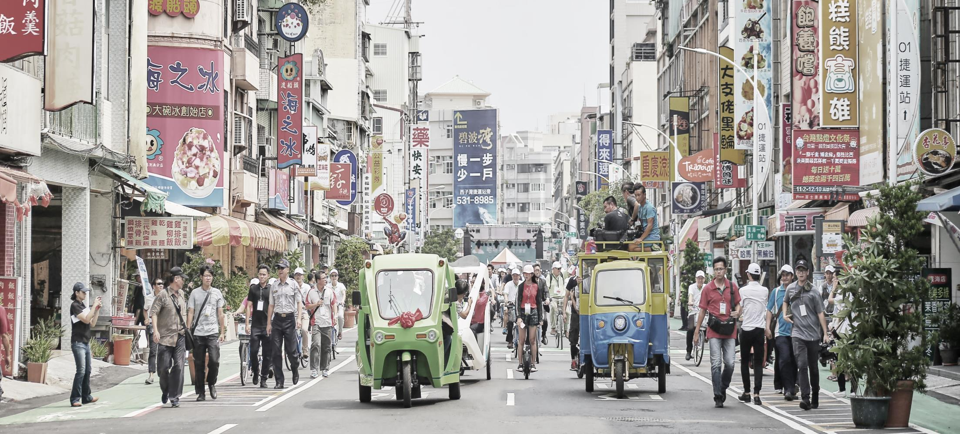







Contact ICLEI’s Sustainable Mobility team:
ecomobility@iclei.org
www.ecomobility.org
@ecomobility_
ICLEI World Secretariat
Kaiser-Friedrich-Str. 7
53113 Bonn, Germany
+49 (0)228 / 976 299-00
Thank you!
Yiqian Zhang
Sustainable Mobility Officer
yiqian.zhang@iclei.org

